Slide 1
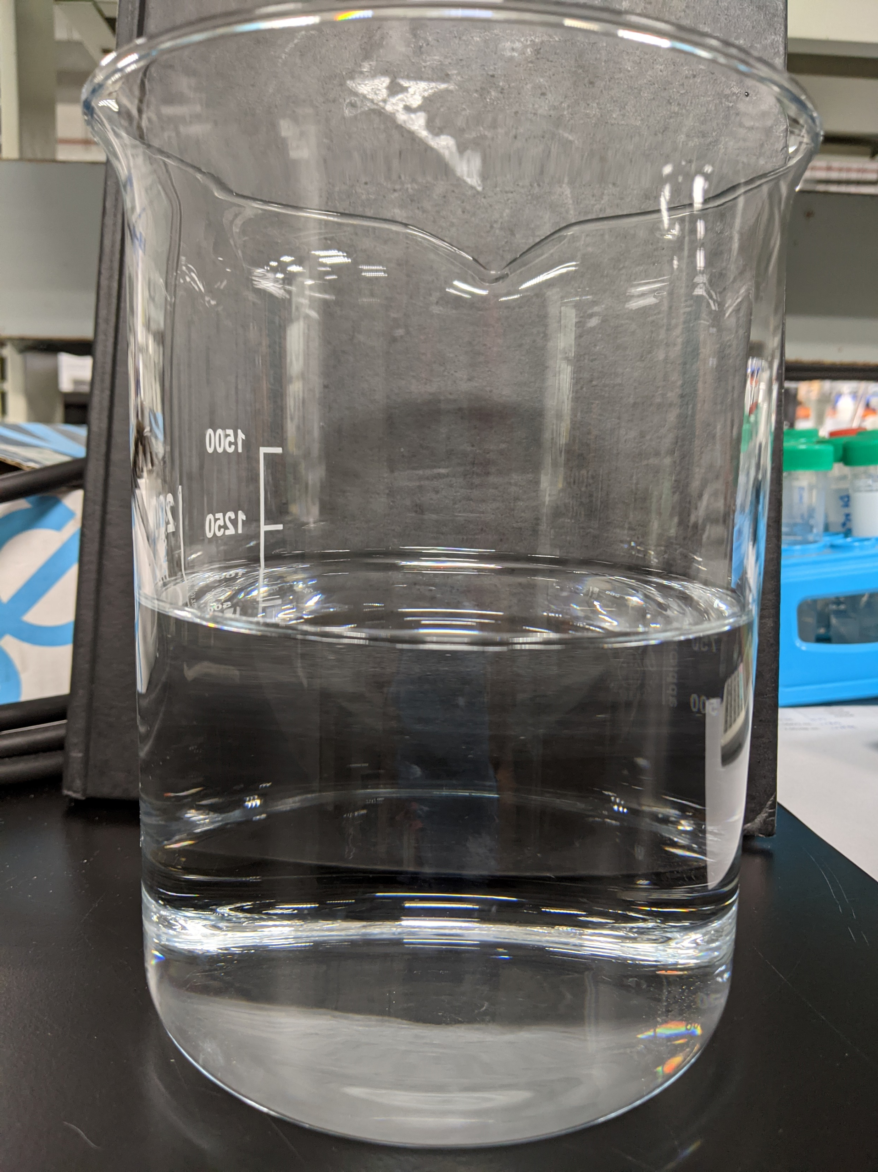
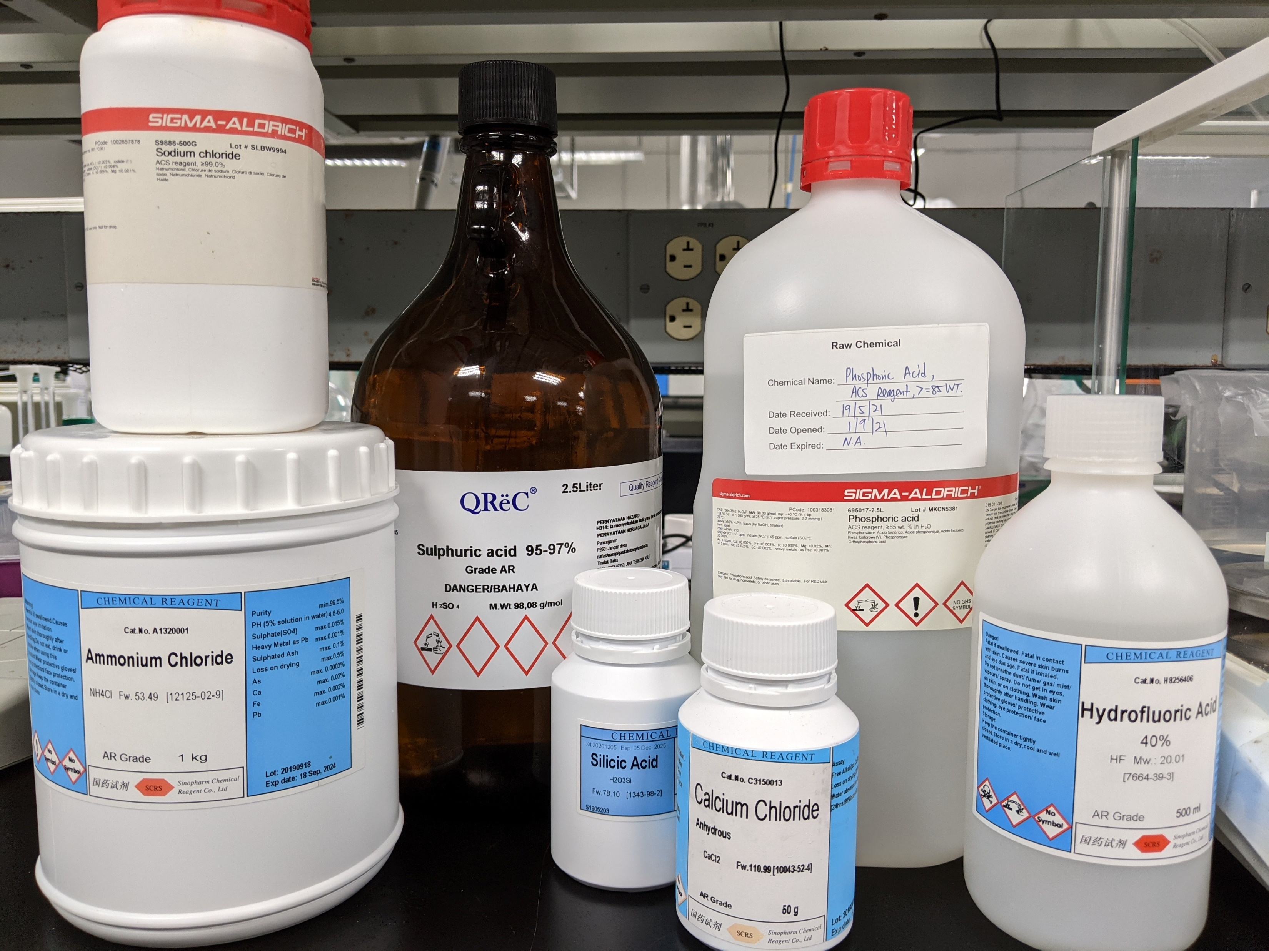
Analysis of HFW Incoming
Elements | Characteristics based on in-house measurements | Units
pH | 3.27 | -
Conductivity | 2132 | µS/cm
Colour (True) | 1,310 | Pt/Co
TDS | 1143 | mg/l
Turbidity | 154 | NTU
TSS | 70 | mg/l
TOC | 28 | mg/l
COD | 334 | O₂ mg/l
Total Chlorine | 1.57 | mg/l
Elements | Concentration based on in-house measurement (ppm)
F | 555.8
Cl | 245.1
I | 6.26
NO3 | 82.1
NH3 | 6.1
Ca | 2.35
Fe | 0.171
Mg | 0.776
Ni | 0.586
K | 0.813
SiO2 | 19.8
Na | 504

Slide 2
Jar testing Procedure
To each testing jar, pour in 1L of wastewater sample
To each jar, dose in 4000 - 7000 mg/L of Ca(OH)2 and rapid mix for 30s
Slow mix for 30 min, measure pH every 15 min
Dose 1mg/L for each of the AN905 polymer (anionic) in each jar and further slower mix (30 rpm) for 30 min. Measure pH every 15 min
Stop mixing and leave the solids to settle over 60 min
Observe sludge settling and measure sludge height every 15 min (if applicable)
Measure turbidity of supernatant and collect the sludge
For the jar with the lowest supernatant turbidity reading, filter out the supernatant through 0.45 um filter and send for analysis and collect the sludge generated
For the sludge collected, filter out using 1.5 µm filter. Collect the sludge, dry sample for XRF analysis.

Slide 3
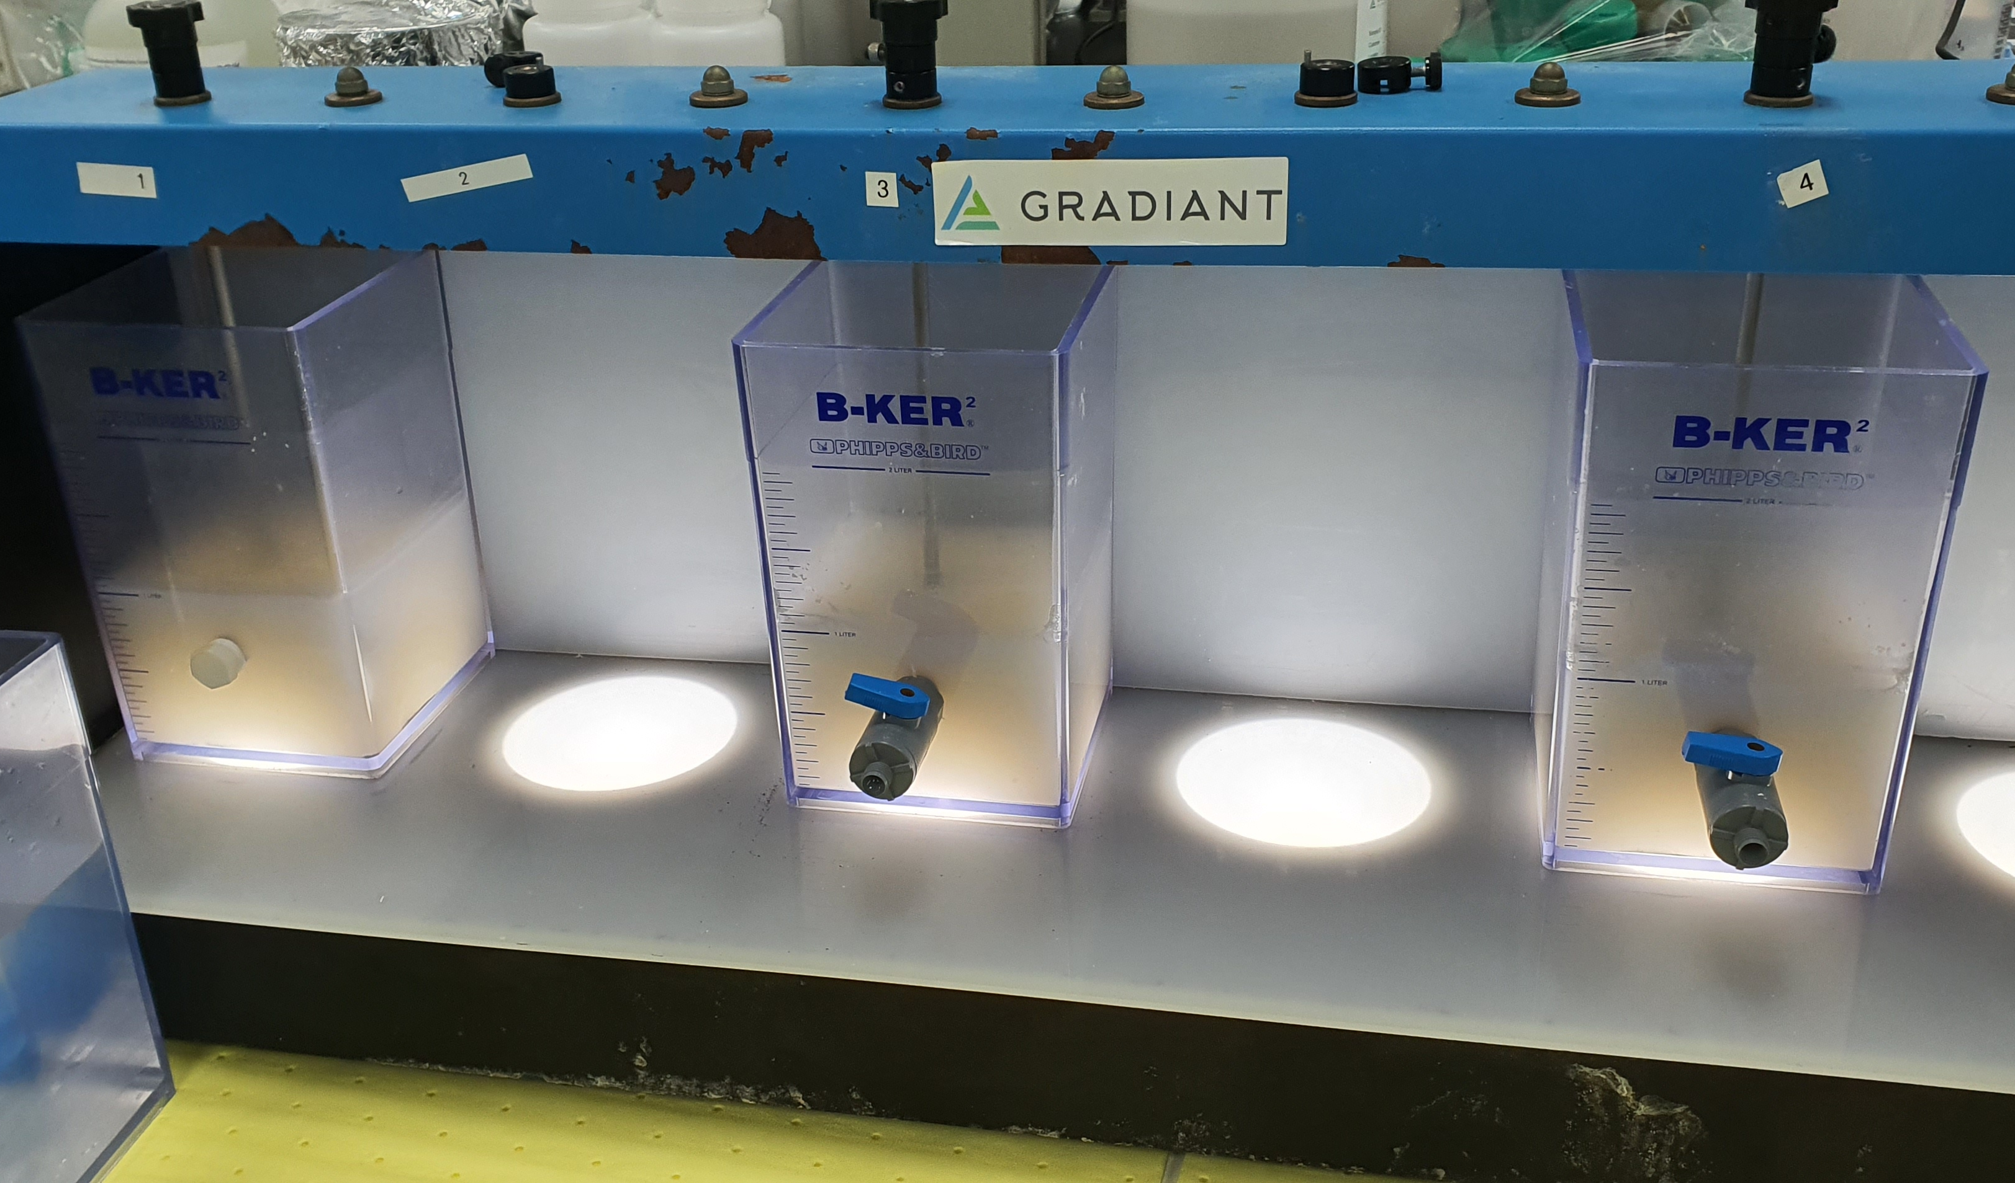
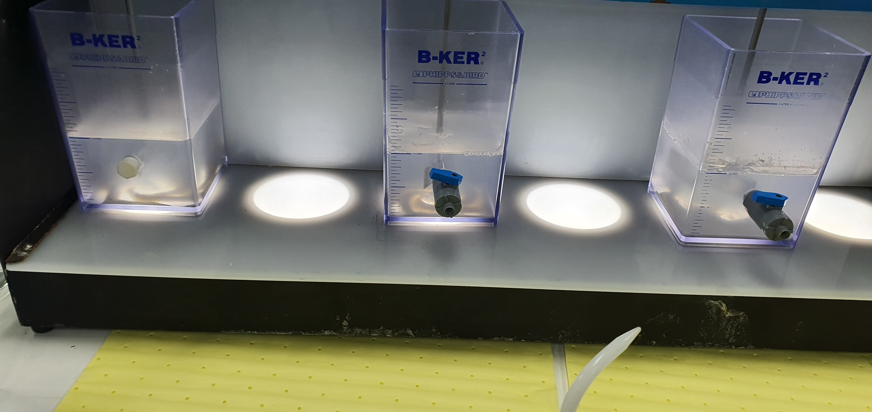
Jar testing of HFW Incoming with Lime
Incoming HFW with added lime in
different dosages
(5000 ppm, 6000 ppm, 7000 ppm)
Solution after the addition of Flocculant (AN 905 SH) Precipitates clumped and settled after the addition of flocculant.

Slide 4
Jar testing of HFW Incoming with Lime
Chemical precipitation with different ppm of Ca(OH)2
Jar | Lime dosage (ppm) | Ph
 |  | t = 0 min | t = 15 min | t = 30 min
1 | 5000 | 3.3 | 12.6 | 12.5
2 | 6000 | 3.3 | 12.6 | 12.5
3 | 7000 | 3.3 | 12.6 | 12.5
Coagulation and flocculation with 1 mg/L anionic polymer (Flopam AN 905 SH)
Jar | Lime dosage (ppm) | pH |  |  | Polymer used
 |  | t = 0 min | t = 15 min | t = 30 min
1 | 5000 | 12.5 | 12.5 | 12.5 | Flopam AN 905 SH
2 | 6000 | 12.5 | 12.5 | 12.5
3 | 7000 | 12.5 | 12.5 | 12.5

Slide 5
Jar testing of HFW Incoming with Lime
Elements | Concentration based on in-house measurement (ppm) | Supernatant quality for Jar 1 | Supernatant quality for Jar 2 | Supernatant quality for Jar 3
Lime dosage | - | 5000 | 6000 | 7000
pH | 3.27 | 12.49 | 12.39 | 12.51
Conductivity | 2,132 µS/cm | 10680 µS/cm | 10220 µS/cm | 10330 µS/cm
Turbidity | 154 NTU | 23.7 NTU | 9.8 NTU | 10.4 NTU
F | 555.8 | 8.516 | 7.875 | 7.371
Cl | 245.1 | 88.446 | 36.321 | 36.69
SO4 | <0.1 | 41.562 | 13.358 | 9.666
NO3 | 82.1 | 76.863 | 78.483 | 77.662
NH3 | 6.1 | 4.8 | 5.3 | 3.4
Ca | 2.35 | 421 | 694 | 633
Fe | 0.171 | <0.1 | <0.1 | <0.1
Mg | 0.776 | <0.1 | <0.1 | <0.1
Ni | 0.581 | <0.1 | <0.1 | <0.1
K | 0.813 | 8.82 | 5.05 | 5.42
SiO2 | 19.8 | <0.1 | <0.1 | <0.1
Na | 504 | 614 | 639 | 581
Notes:
Might want to remove sulfate row.

Slide 6
Jar testing of HFW Incoming with Lime
Sludge collected from vacuum filtration and dried in 80C oven.
Jar | Lime dosage (ppm) | Weight of Wet Sludge (g) | Weight of Dry Sludge (g) | Moisture Content of Wet Sludge
1 | 5000 | 11.985 | 4.037 | 66.3%
2 | 6000 | 13.304 | 4.851 | 63.5%
3 | 7000 | 14.051 | 5.745 | 59.1%

Slide 7
Analysis of HFW Pump Discharge
Elements | Characteristics based on in-house measurements | Units
pH | 3.42 | -
Conductivity | 1794 | µS/cm
Colour (True) | 350 | Pt/Co
TDS | 956.9 | mg/l
Turbidity | 154 | NTU
TSS | 83 | mg/l
TOC | 26.71 | mg/l
COD | 277 | O₂ mg/l
Total Chlorine | 1.16 | mg/l
Elements | Concentration based on in-house measurement (ppm)
F | 455.8
Cl | 251.3
SO4 | 30.6
I | 4.1
NO3 | 61.6
NH3 | 56
Al | 10.9
B | 0.778
Ca | 4.09
Fe | 0.129
Mg | 0.688
Ni | 0.52
K | 1.5
SiO2 | 55
Na | 308

Slide 8
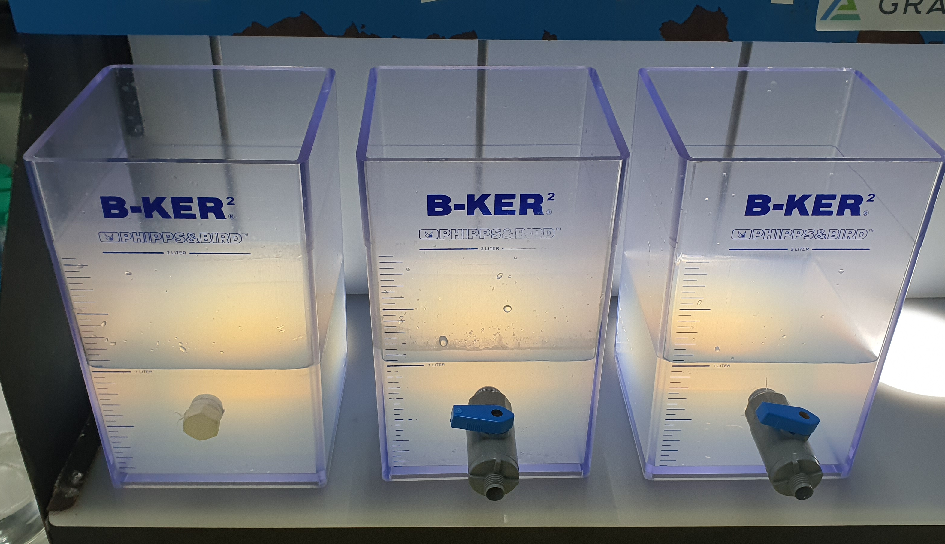
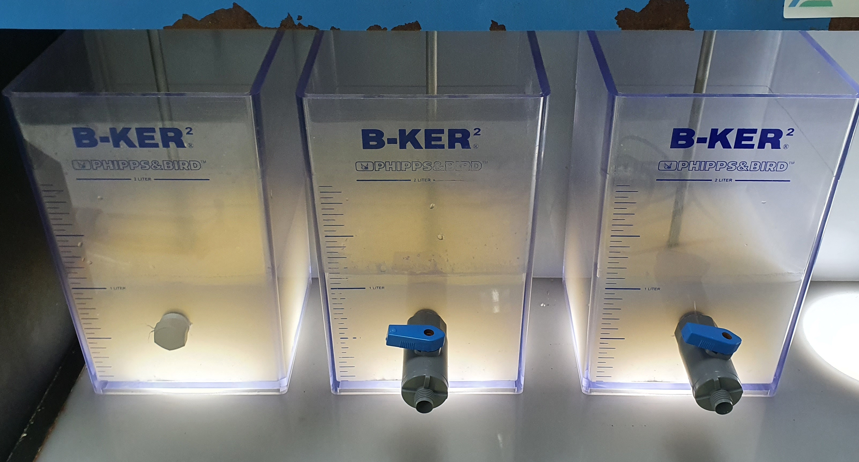
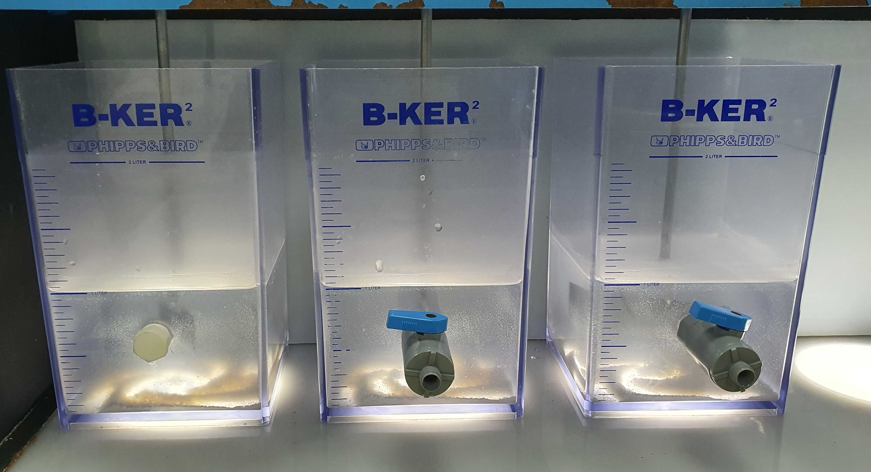
Treatment 1: Jar testing of HFW pump discharge with Lime
HFW Pump Discharge solution in different jars
HFW Pump Discharge with added lime at different dosages (4000, 5000, 6000 ppm)
Solution with added flocculant (Flopam AN 905 SH). Precipitates clumped and settled after the addition of flocculant.

Slide 9
Treatment 1: Jar testing of HFW pump discharge with Lime
Chemical precipitation with Ca(OH)2
Jar | Lime dosage (ppm) | pH
 |  | t = 0 min | t = 15 min | t = 30 min
1 | 4000 | 3.65 | 12.49 | 12.46
2 | 5000 | 3.65 | 12.49 | 12.53
3 | 6000 | 3.69 | 12.46 | 12.56
Coagulation and flocculation with 1 mg/L anionic polymer
Jar | Lime dosage (ppm) | pH |  |  | Polymer used
 |  | t = 0 min | t = 15 min | t = 30 min
1 | 4000 | 12.46 | 12.48 | 12.49 | Flopam AN 905 SH
2 | 5000 | 12.53 | 12.49 | 12.44 | Flopam AN 905 SH
3 | 6000 | 12.56 | 12.52 | 12.44 | Flopam AN 905 SH

Slide 10
Treatment 1: Jar testing of HFW pump discharge with Lime
Elements | Concentration, in-house measurement (ppm) | Supernatant quality for Jar 1 | Supernatant quality for Jar 2 | Supernatant quality for Jar 3
pH | 3.42 | 12.49 | 12.44 | 12.44
Turbidity | 154 NTU | 13.1 NTU | 13.5 NTU | 15.8 NTU
F | 455.8 | 8.98 | 8.68 | 8.55
Cl | 251.3 | 46.6 | 46.5 | 46.4
SO4 | 30.6 | 7.37 | 8.09 | 9.36
NO3 | 61.6 | 58.2 | 58.1 | 58.8
Al | 10.9 | <0.1 | <0.1 | <0.1
Ba | <0.1 | 0.118 | 0.128 | 0.13
B | 0.778 | 1.53 | 1.55 | 1.60
Ca | 4.09 | 711 | 756 | 757
Fe | 0.129 | <0.1 | <0.1 | <0.1
Mg | 0.688 | <0.1 | <0.1 | <0.1
Ni | 0.52 | <0.1 | <0.1 | <0.1
K | 1.5 | 12.7 | 13.1 | 13.5
SiO2 | 55 | <0.1 | 0.227 | 0.227
Na | 308 | 334 | 358 | 344
Sr | <0.1 | 0.445 | 0.509 | 0.551

Slide 11
Treatment 1: Jar testing of HFW pump discharge with Lime
Sludge collected from vacuum filtration and dried in 80C oven.
Jar | Lime dosage (ppm) | Weight of Wet Sludge (g) | Weight of Dry Sludge (g) | Moisture Content of Wet Sludge
1 | 4000 | 10.627 | 3.010 | 71.7%
2 | 5000 | 12.742 | 3.962 | 68.9%
3 | 6000 | 14.892 | 4.909 | 67.0%

Slide 12
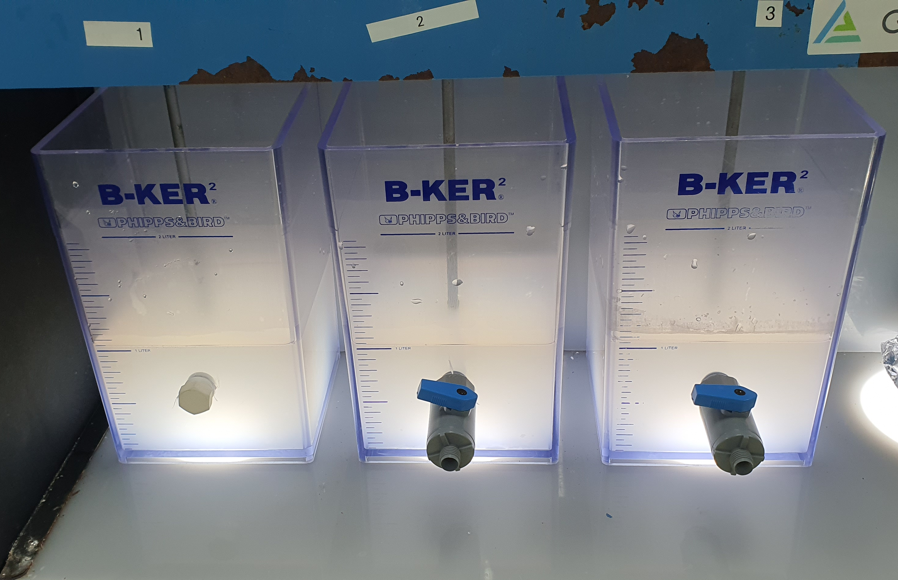
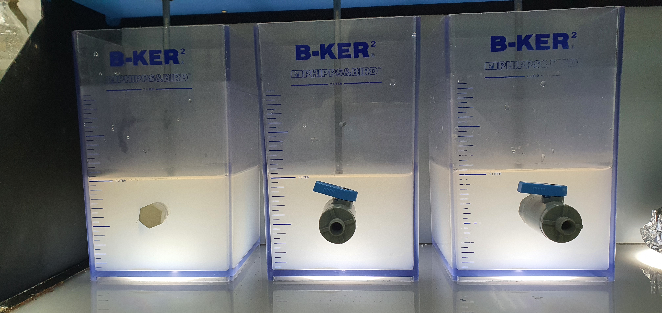
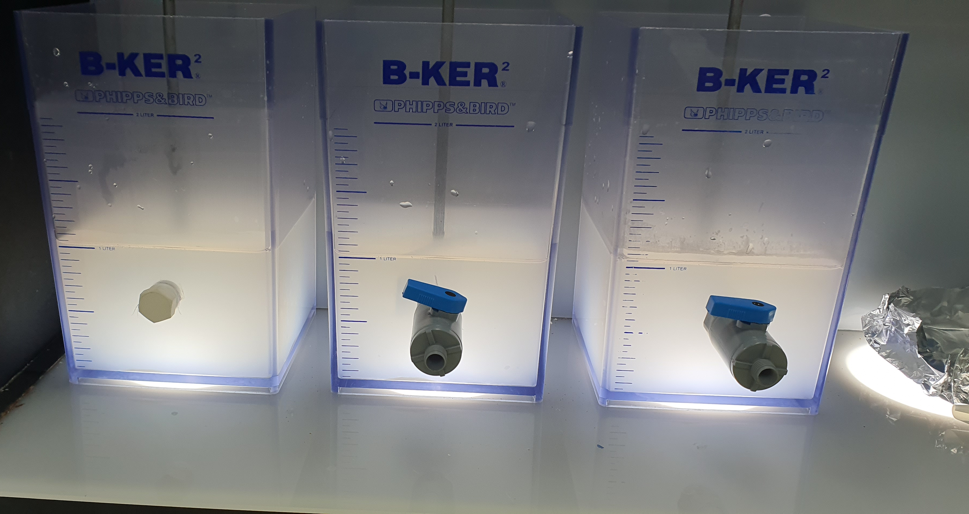
Treatment 2A: Jar testing of HFW pump discharge with CaCl2 and NaOH pH adjustment
HFW Pump Discharge solution in different jars
HFW Pump Discharge adjusted pH to 7-8 with NaOH, added CaCl2 at different dosages (2500, 3000, 4000 ppm),
Solution with added flocculant (Flopam AN 905 SH). Solution stays turbid even with addition of flocculant, and did not settle down

Slide 13
Treatment 2A: Jar testing of HFW pump discharge with CaCl2 and NaOH pH adjustment
Chemical precipitation with pH adjustment, then CaCl2
Jar | CaCl2 dosage (ppm) | NaOH dosage (ppm) | pH | pH
 |  |  | Initial pH adjustment | t = 0 min | t = 15 min | t = 30 min
1 | 2500 | 450 | 7.96 | 6.4 | 6.4 | 6.4
2 | 3000 | 440 | 7.5 | 6.5 | 6.4 | 6.6
3 | 4000 | 450 | 7.44 | 6.4 | 6.4 | 6.5
Coagulation and flocculation with 1 mg/L anionic polymer
Jar | CaCl2 dosage (ppm) | NaOH dosage (ppm) | pH |  |  | Polymer used
 |  |  | t = 0 min | t = 15 min | t = 30 min
1 | 2500 | 450 | 6.4 | 6.5 | 6.5 | Flopam AN 905 SH
2 | 3000 | 440 | 6.6 | 6.6 | 6.6 | Flopam AN 905 SH
3 | 4000 | 450 | 6.5 | 6.5 | 6.5 | Flopam AN 905 SH

Slide 14
Treatment 2A: Jar testing of HFW pump discharge with CaCl2 and NaOH pH adjustment
Elements | Concentration, in-house measurement (ppm) | Supernatant quality for Jar 1 | Supernatant quality for Jar 2 | Supernatant quality for Jar 3
pH | 3.42 | 6.5 | 6.6 | 6.5
Turbidity | 154 NTU | 123 NTU | 131 NTU | 209 NTU
F | 455.8 | 11.3 | 11.0 | 12.8
Cl | 251.3 | 1,446 | 1,489 | 1,298
SO4 | 30.6 | 4.31 | 4.54 | 4.95
NO3 | 61.6 | 57.3 | 58.2 | 57.1
Al | 10.9 | <0.1 | <0.1 | <0.1
Ba | <0.1 | 0.204 | 0.111 | 0.109
B | 0.778 | 1.51 | 1.53 | 1.58
Ca | 4.09 | 405 | 423 | 325
Fe | 0.129 | <0.1 | <0.1 | <0.1
Mg | 0.688 | 1.72 | 1.81 | 1.47
Ni | 0.52 | <0.1 | <0.1 | <0.1
K | 1.5 | 11.0 | 4.77 | 8.38
SiO2 | 55 | 44.7 | 45.3 | 44.8
Na | 308 | 548 | 544 | 569
Sr | <0.1 | 0.344 | 0.366 | 0.284

Slide 15
Treatment 2A: Jar testing of HFW pump discharge with CaCl2 and NaOH pH adjustment
Sludge collected from vacuum filtration, discarded as no solids are visible.
Jar | CaCl2 dosage (ppm) | NaOH dosage (ppm) | Weight of Wet Sludge (g) | Weight of Dry Sludge (g) | Moisture Content of Wet Sludge
1 | 2500 | 450 | 6.108 | Sludge was not dried for this testing, as there is very little to be obtained.
2 | 3000 | 440 | 4.003
3 | 4000 | 450 | 4.141

Slide 16
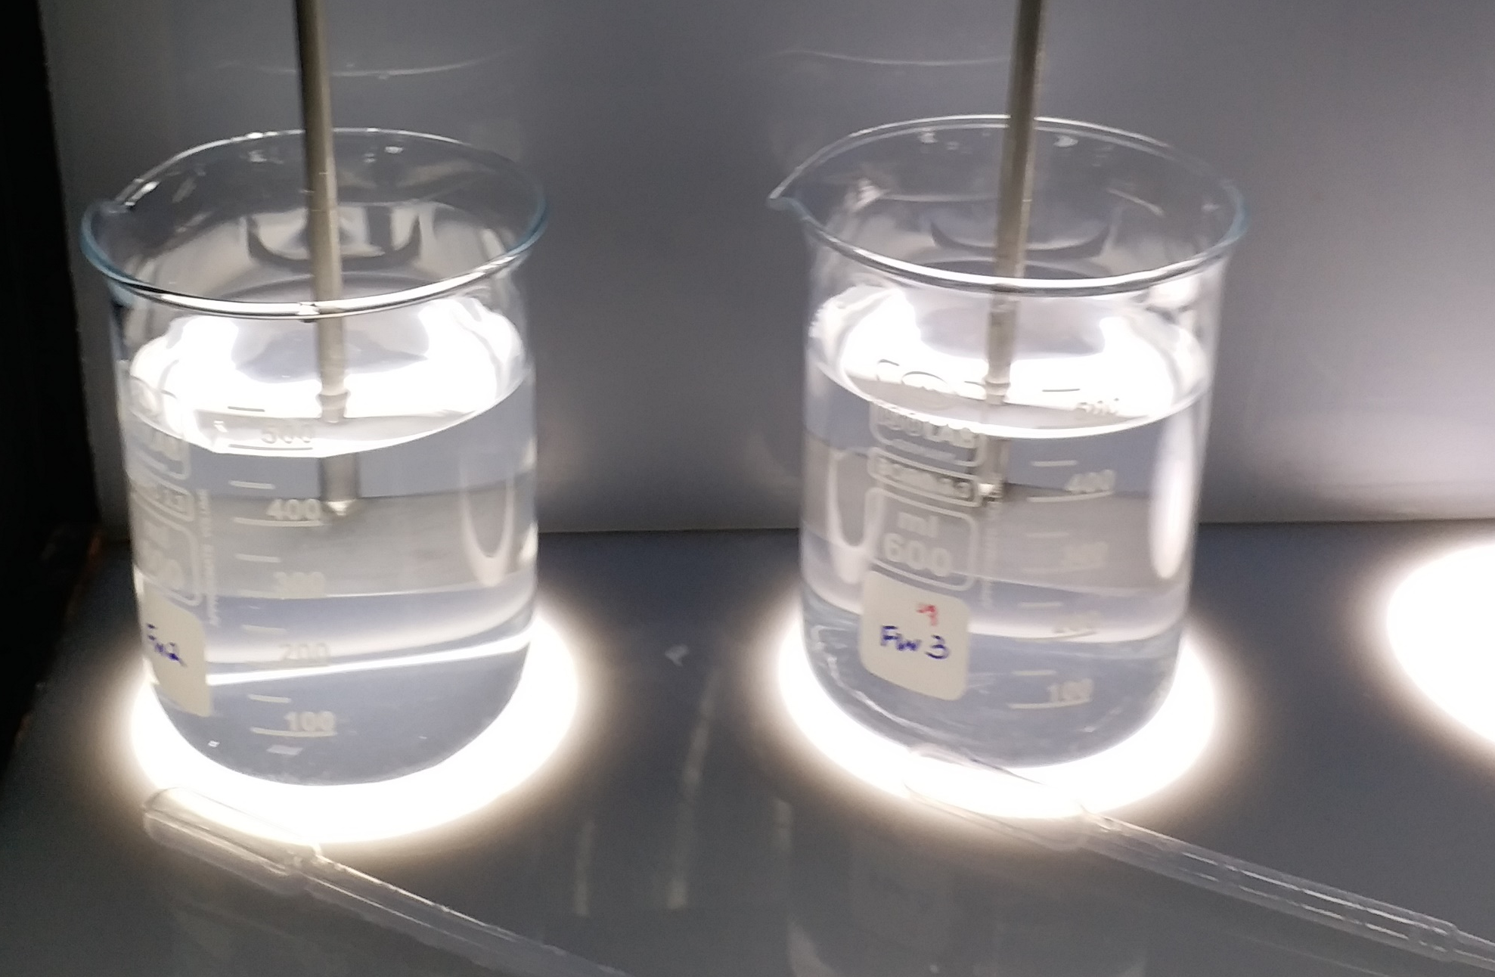
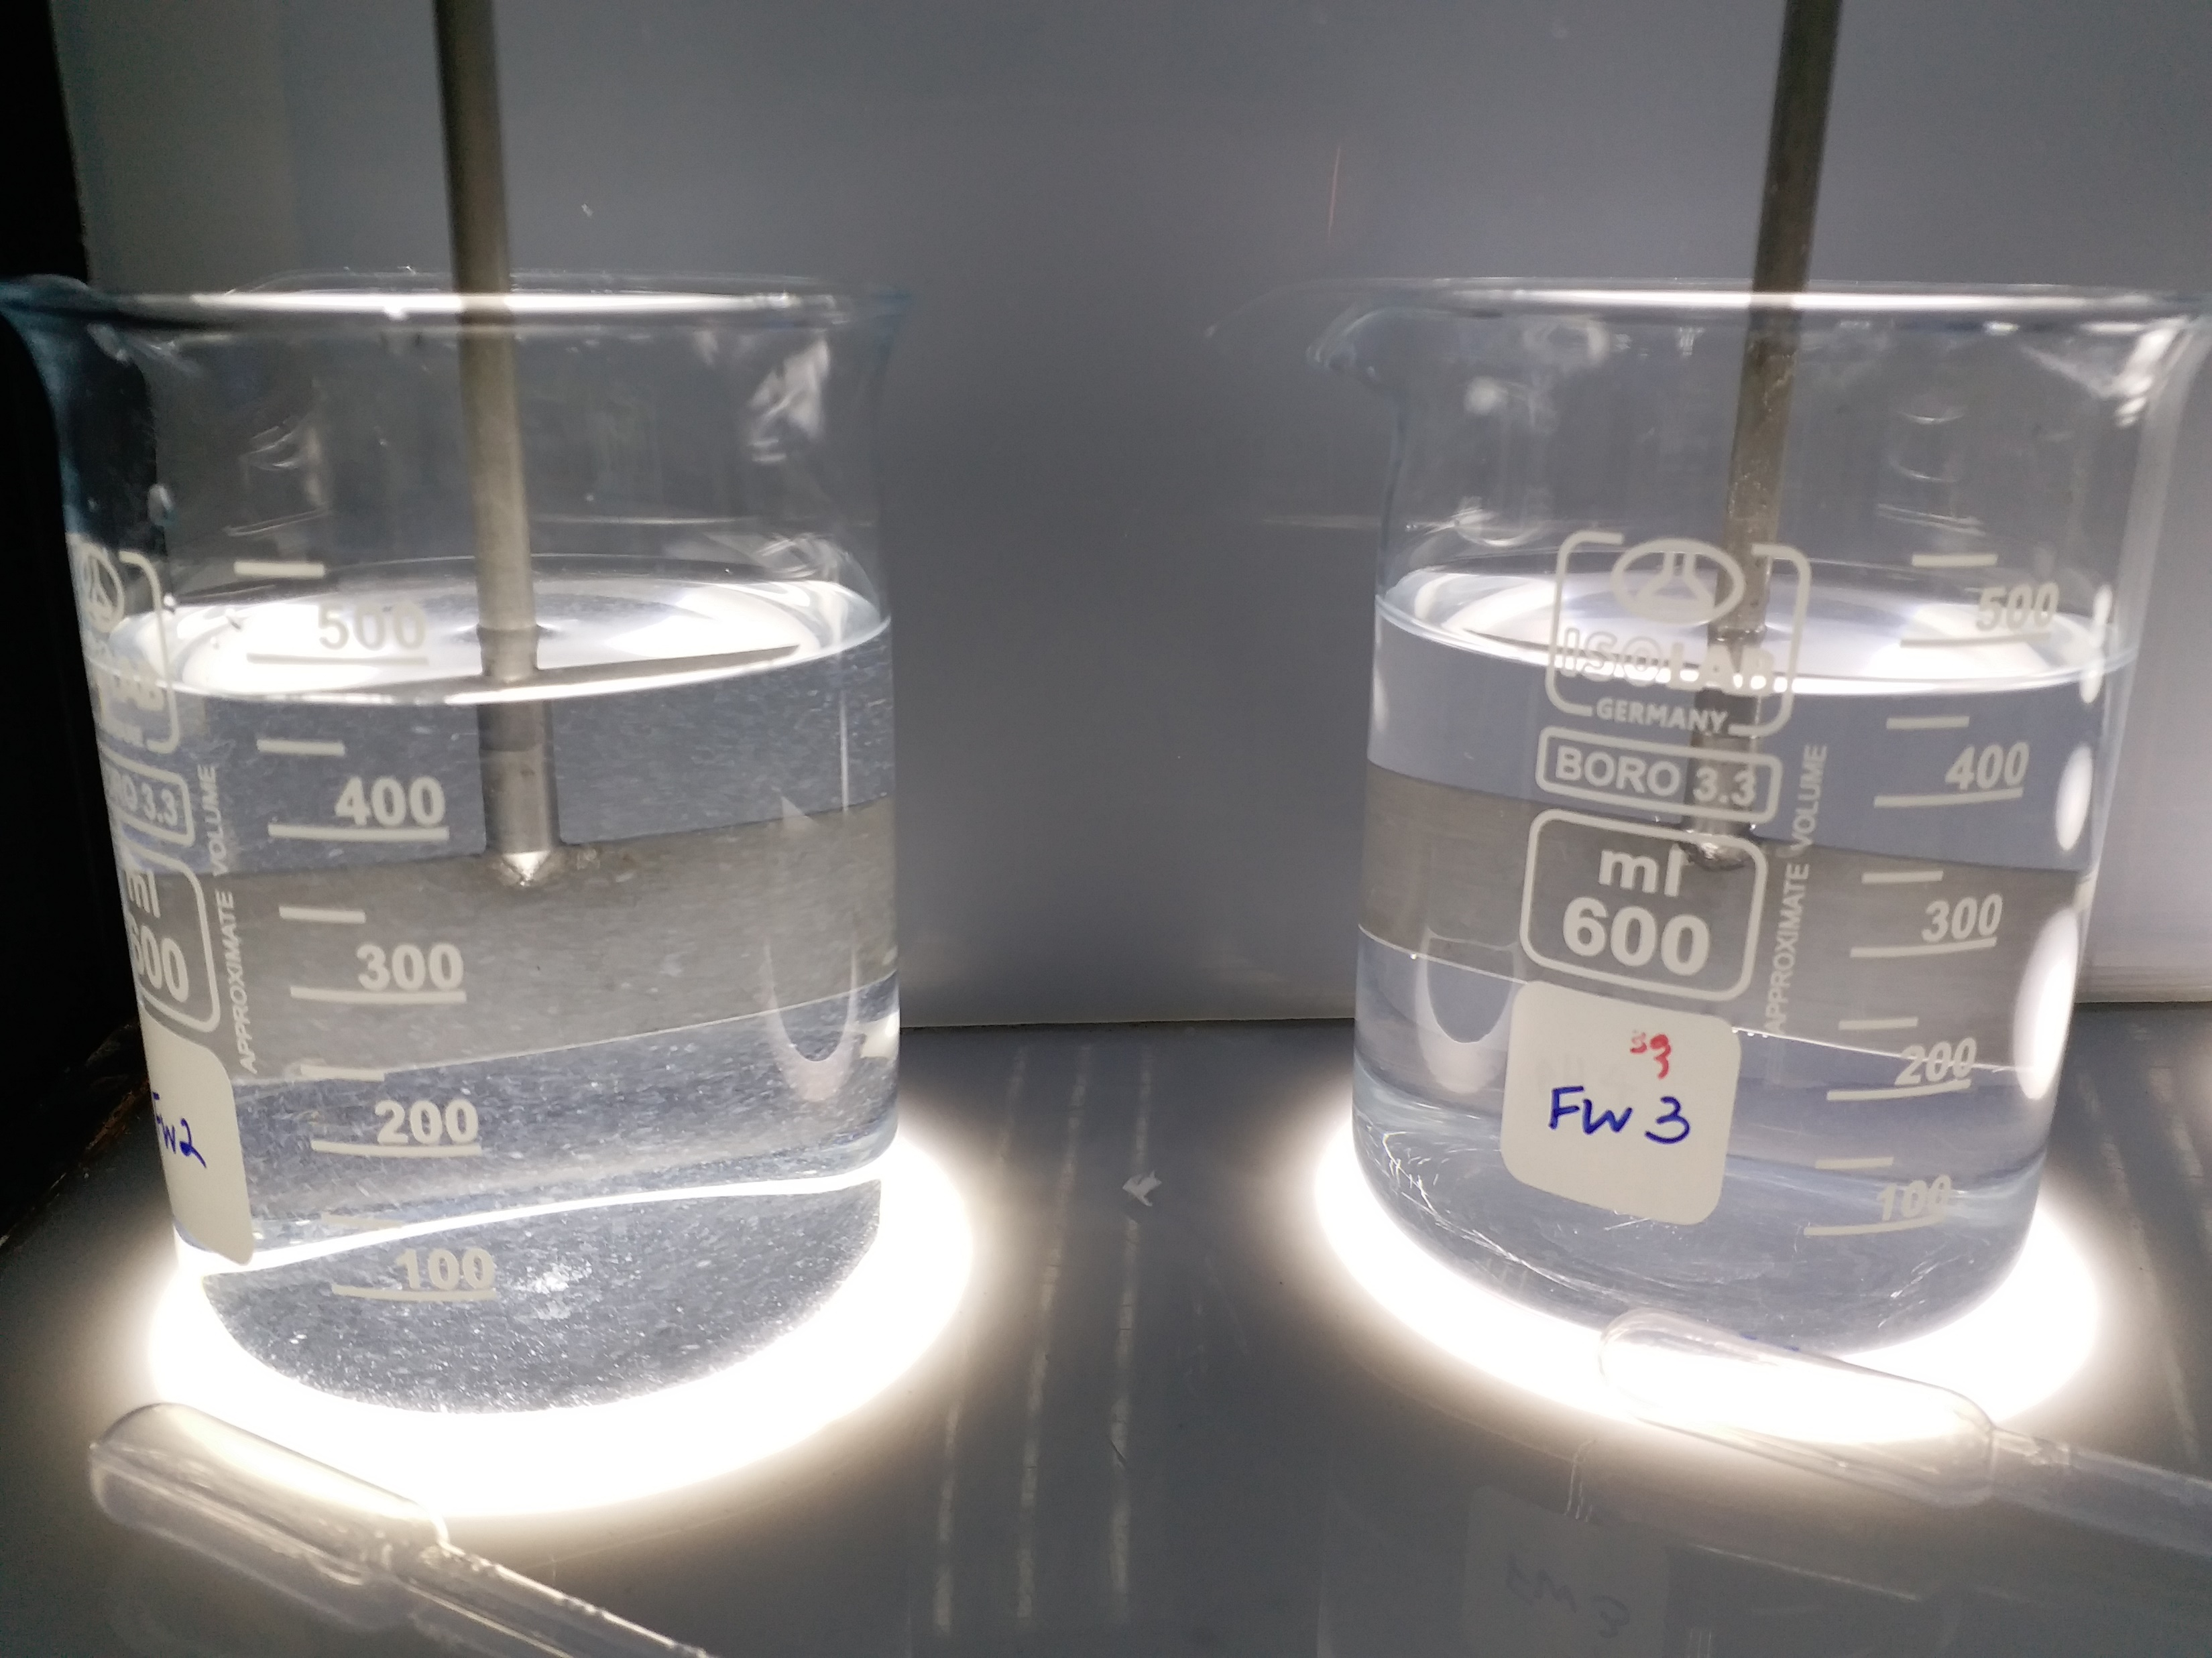
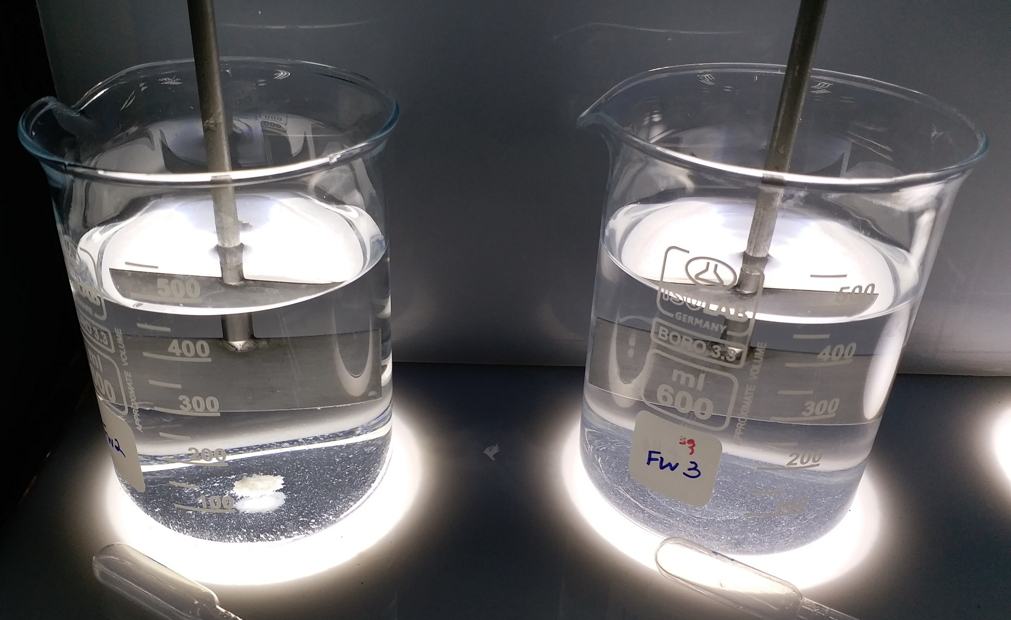
Treatment 2B: Jar testing of treated water in 2A with CaCl2
500mL of HFW Pump Discharge Supernatant for 2500 ppm and 3000 ppm retained
Added further 1000 ppm of CaCl2 to both jars. (3500, 4000 ppm CaCl2 in total)
Solution with added flocculant (Flopam AN 905 SH). Precipitates clumped and settled after the addition of flocculant.

Slide 17
Treatment 2B: Jar testing of treated water in 2A with CaCl2
Chemical precipitation with CaCl2
Jar | CaCl2 dosage (ppm) | NaOH dosage (ppm) | pH
 |  |  | t = 0 min | t = 15 min | t = 30 min
1 | 2500 + 1000 | 450 | 7.3 | 7.29 | 7.31
2 | 3000 + 1000 | 440 | 7.3 | 7.29 | 7.31
Coagulation and flocculation with 1 mg/L anionic polymer
Jar | CaCl2 dosage (ppm) | NaOH dosage (ppm) | pH |  |  | Polymer used
 |  |  | t = 0 min | t = 15 min | t = 30 min
1 | 2500 + 1000 | 450 | 7.31 | 7.34 | 7.32 | Flopam AN 905 SH
2 | 3000 + 1000 | 440 | 7.31 | 7.19 | 7.18 | Flopam AN 905 SH

Slide 18
Treatment 2B: Jar testing of treated water in 2A with CaCl2
Elements | Supernatant quality for Jar 1 (Pre-treatment) | Supernatant quality for Jar 2 (Pre-treatment) | Supernatant quality for Jar 1 (Post-treatment) | Supernatant quality for Jar 2 (Post-treatment)
pH | 6.5 | 6.6 | 7.32 | 7.18
Turbidity | 123 NTU | 131 NTU | 1.84 NTU | 4.11 NTU
F | 11.3 | 11.0 | 6.39 | 6.82
Cl | 1,446 | 1,489 | 2,056 | 2,005
SO4 | 4.31 | 4.54 | 5.98 | 5.08
NO3 | 57.3 | 58.2 | 53.7 | 53.2
Al | <0.1 | <0.1 | <0.1 | <0.1
Ba | 0.204 | 0.111 | 0.45 | 0.351
B | 1.51 | 1.53 | 1.57 | 1.60
Ca | 405 | 423 | 728 | 753
Fe | <0.1 | <0.1 | <0.1 | <0.1
Mg | 1.72 | 1.81 | 2.79 | 2.54
Ni | <0.1 | <0.1 | <0.1 | <0.1
K | 11.0 | 4.77 | 11.0 | 12.8
SiO2 | 44.7 | 45.3 | 45.0 | 43.7
Na | 548 | 544 | 567 | 541
Sr | 0.344 | 0.366 | 0.500 | 0.534
Zn | <0.1 | <0.1 | 0.119 | 0.114
Notes:
Omitted strontium and barium

Slide 19
Treatment 2B: Jar testing of treated water in 2A with CaCl2
Sludge collected from vacuum filtration and dried in 80C oven.
Jar | CaCl2 dosage (ppm) | Lime dosage (ppm) | Weight of Wet Sludge (g) | Weight of Dry Sludge (g) | Moisture Content of Wet Sludge
1 | 2500 + 1000 | 450 | 2.143 | 0.026 | 98.8%
2 | 3000 + 1000 | 440 | 2.28 | 0.026 | 98.9%

Slide 20
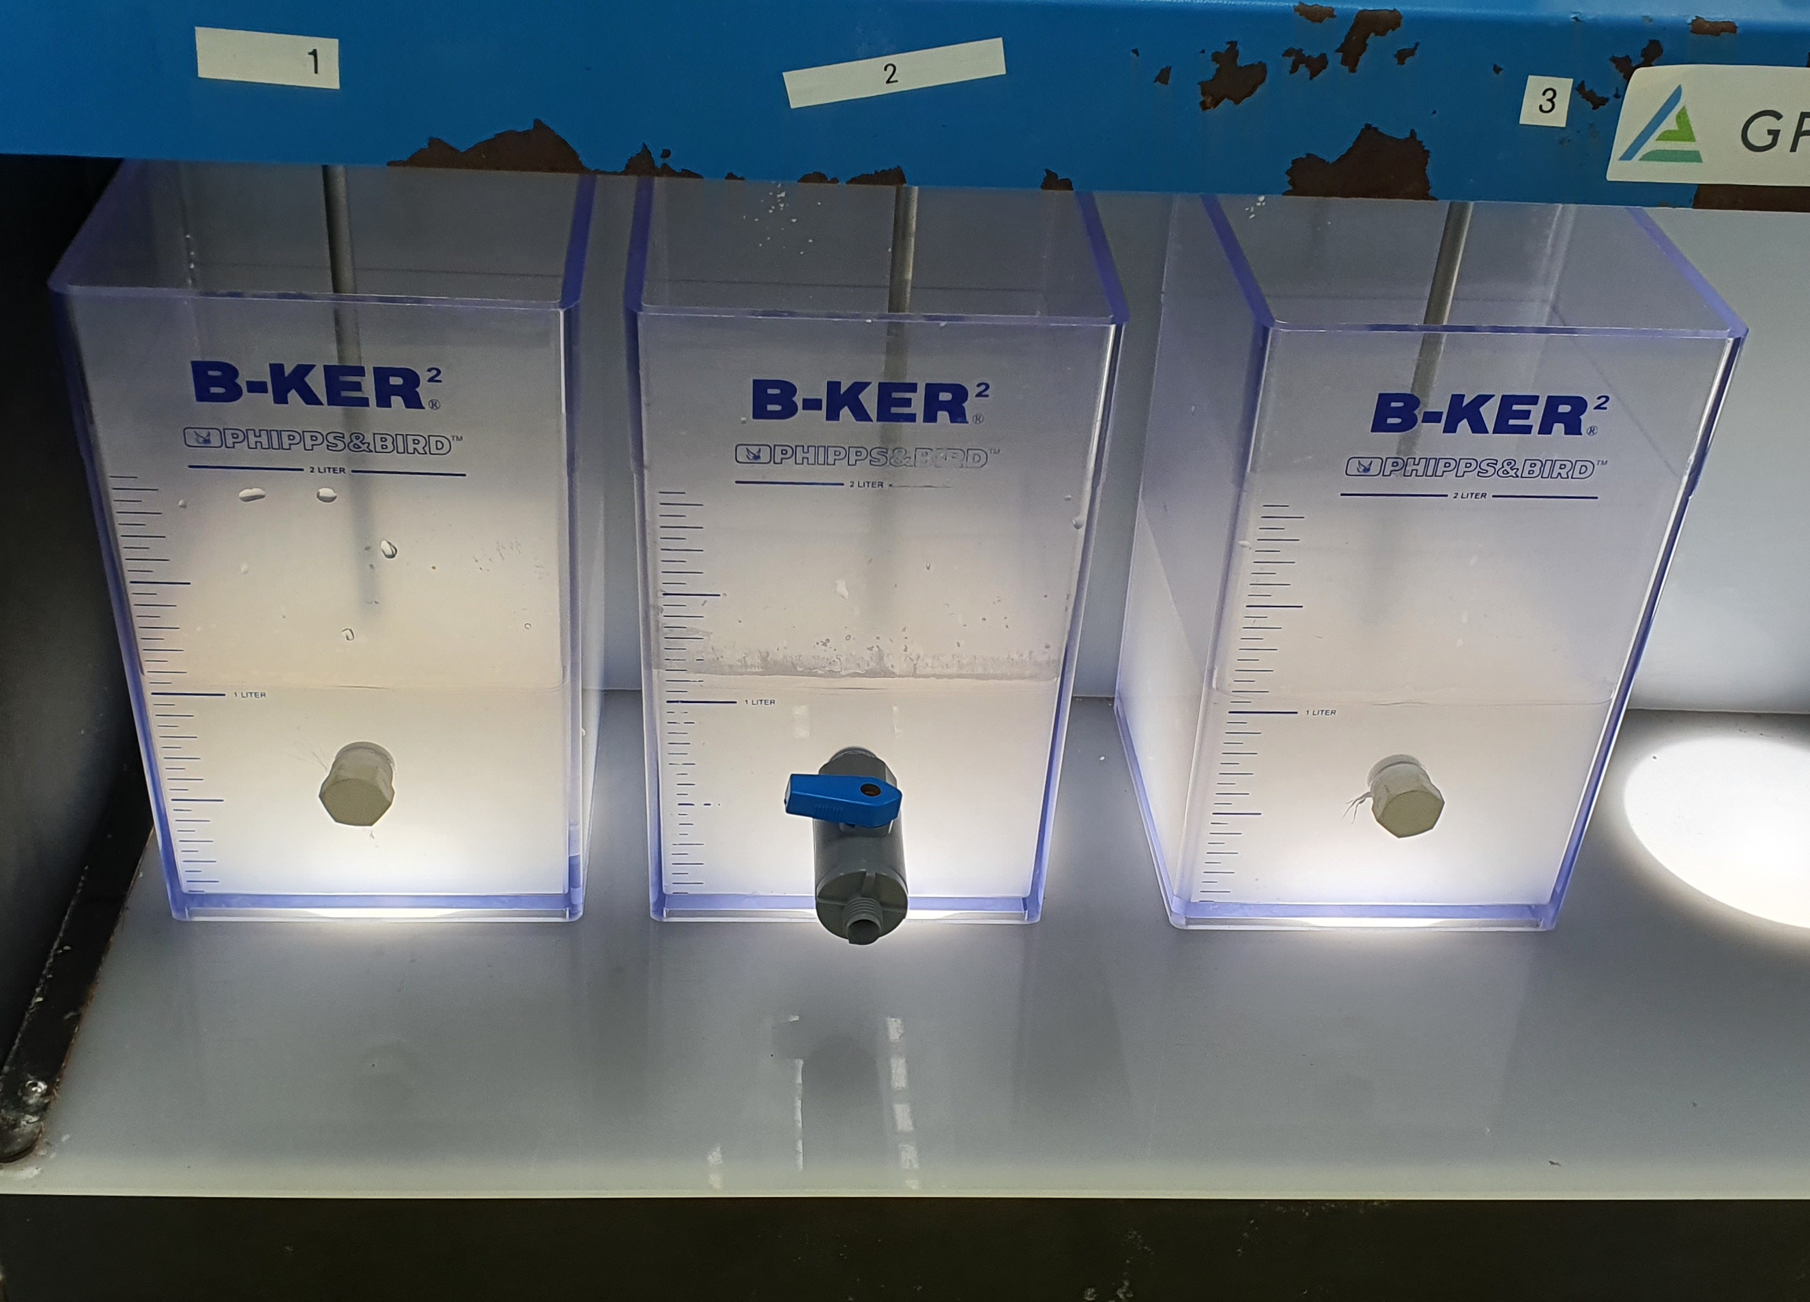
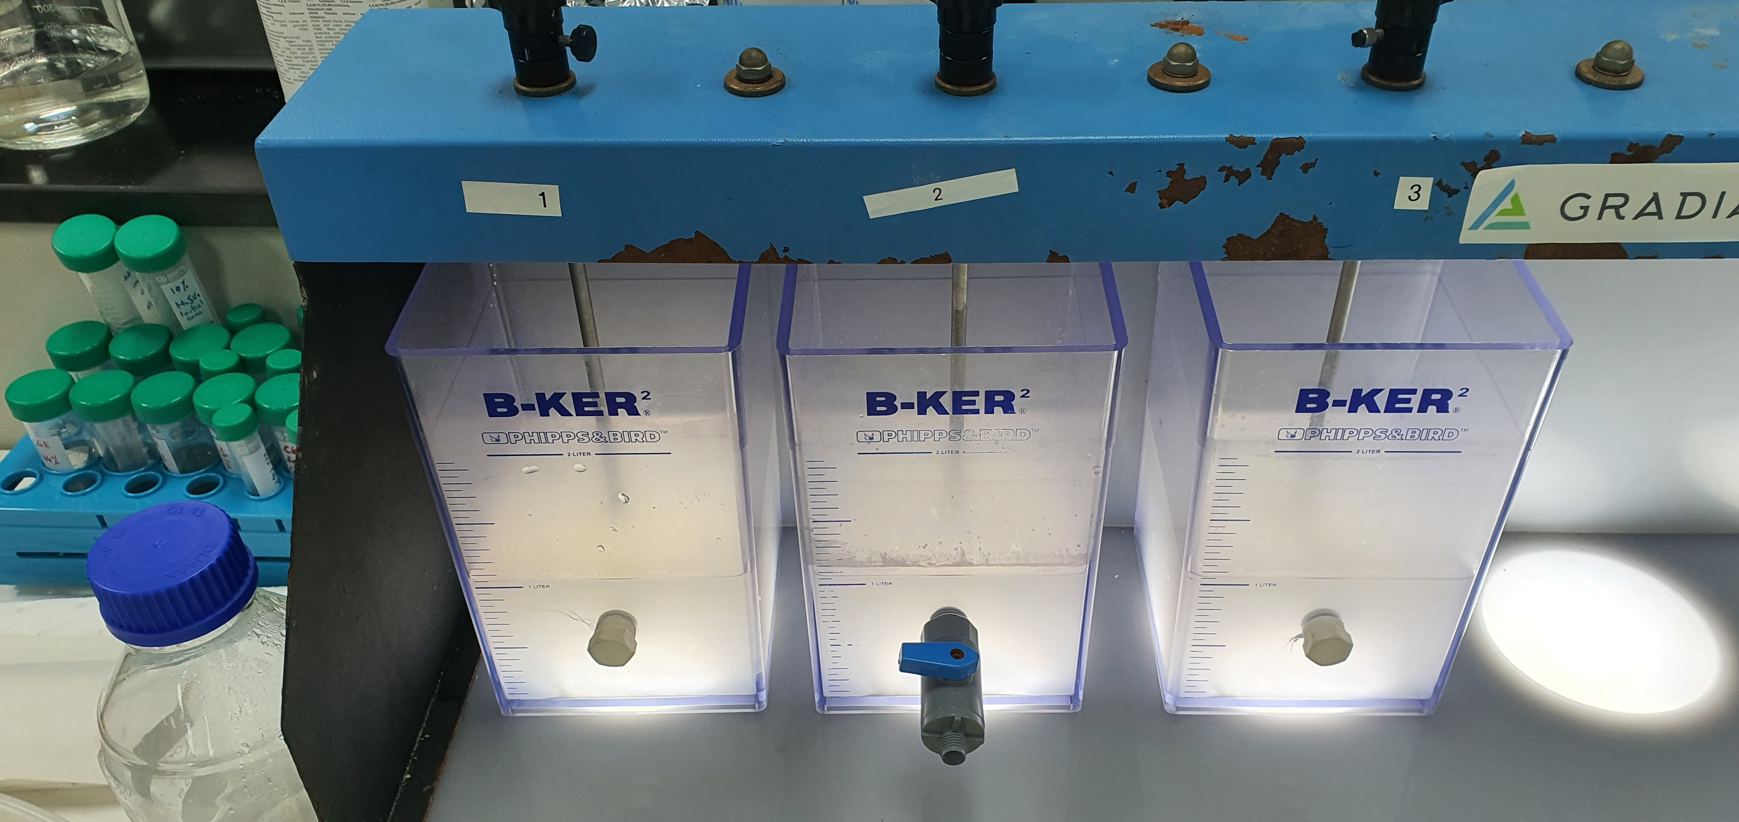
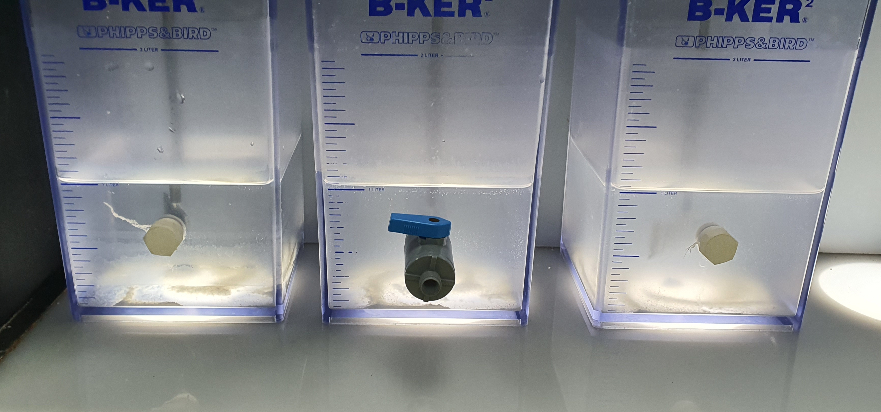
Treatment 3: Jar testing of HFW pump discharge with CaCl2 and lime pH adjustment
HFW Pump Discharge solution in different jars
HFW Pump Discharge adjusted pH to >8 with Lime, added CaCl2 at different dosages (1500, 2000, 2500 ppm)
Solution with added flocculant (Flopam AN 905 SH). Precipitates clumped and settled after the addition of flocculant.

Slide 21
Treatment 3: Jar testing of HFW pump discharge with CaCl2 and lime pH adjustment
Chemical precipitation with pH adjustment, then CaCl2
Jar | CaCl2 dosage (ppm) | Lime dosage (ppm) | pH | pH
 |  |  | Initial pH adjustment | t = 0 min | t = 15 min | t = 30 min
1 | 1500 | 550 | 8.66 | 8.19 | 8.92 | 9.1
2 | 2000 | 600 | 9.04 | 8.59 | 9.15 | 9.3
3 | 2500 | 800 | 10.43 | 10.02 | 10.41 | 10.52
Coagulation and flocculation with 1 mg/L anionic polymer
Jar | CaCl2 dosage (ppm) | Lime dosage (ppm) | pH |  |  | Polymer used
 |  |  | t = 0 min | t = 15 min | t = 30 min
1 | 1500 | 550 | 9.1 | 9.1 | 9.08 | Flopam AN 905 SH
2 | 2000 | 600 | 9.3 | 9.29 | 9.28 | Flopam AN 905 SH
3 | 2500 | 800 | 10.52 | 10.49 | 10.47 | Flopam AN 905 SH

Slide 22
Treatment 3: Jar testing of HFW pump discharge with CaCl2 and lime pH adjustment
Elements | Concentration, in-house measurement (ppm) | Supernatant quality for Jar 1 | Supernatant quality for Jar 2 | Supernatant quality for Jar 3
pH | 3.42 | 9.08 | 9.28 | 10.47
Turbidity | 154 NTU | 3.64 NTU | 9.31 NTU | 15.9 NTU
F | 455.8 | 18.6 | 11.2 | 10.4
Cl | 251.3 | 888 | 1,160 | 1,458
SO4 | 30.6 | 6.86 | 7.03 | 10.2
NO3 | 61.6 | 58.3 | 58.8 | 57.0
Al | 10.9 | 0.195 | 0.313 | 2.46
Ba | <0.1 | 0.103 | 0.107 | 0.111
B | 0.778 | 1.29 | 1.13 | 1.03
Ca | 4.09 | 294 | 454 | 677
Fe | 0.129 | <0.1 | <0.1 | <0.1
Mg | 0.688 | 1.61 | 1.92 | 2.15
Ni | 0.52 | <0.1 | <0.1 | <0.1
K | 1.5 | 8.31 | 5.78 | 14.0
SiO2 | 55 | 13.3 | 4.17 | 0.873
Na | 308 | 294 | 292 | 293
Sr | <0.1 | 0.269 | 0.389 | 0.491
Notes:
Omitted strontium and barium

Slide 23
Treatment 3: Jar testing of HFW pump discharge with CaCl2 and lime pH adjustment
Sludge collected from vacuum filtration and dried in 80C oven.
Jar | CaCl2 dosage (ppm) | Lime dosage (ppm) | Weight of Wet Sludge (g) | Weight of Dry Sludge (g) | Moisture Content of Wet Sludge
1 | 1500 | 550 | 4.484 | 1.223 | 72.7%
2 | 2000 | 600 | 5.575 | 2.15 | 61.4%
3 | 2500 | 800 | 4.754 | 1.346 | 71.7%

